Slide 1
On the journey of an enterprise transformation, Quality is still Job 1
Reena Mathew
Principal Architect, Salesforce
@reenamathew
Dave Mangot
Architect, Salesforce
@davemangot

Slide 2
Safe Harbor
Safe harbor statement under the Private Securities Litigation Reform Act of 1995:
This presentation may contain forward-looking statements that involve risks, uncertainties, and assumptions. If any such uncertainties materialize or if any of the assumptions proves incorrect, the results of salesforce.com, inc. could differ materially from the results expressed or implied by the forward-looking statements we make. All statements other than statements of historical fact could be deemed forward-looking, including any projections of product or service availability, subscriber growth, earnings, revenues, or other financial items and any statements regarding strategies or plans of management for future operations, statements of belief, any statements concerning new, planned, or upgraded services or technology developments and customer contracts or use of our services.
The risks and uncertainties referred to above include – but are not limited to – risks associated with developing and delivering new functionality for our service, new products and services, our new business model, our past operating losses, possible fluctuations in our operating results and rate of growth, interruptions or delays in our Web hosting, breach of our security measures, the outcome of any litigation, risks associated with completed and any possible mergers and acquisitions, the immature market in which we operate, our relatively limited operating history, our ability to expand, retain, and motivate our employees and manage our growth, new releases of our service and successful customer deployment, our limited history reselling non-salesforce.com products, and utilization and selling to larger enterprise customers. Further information on potential factors that could affect the financial results of salesforce.com, inc. is included in our annual report on Form 10-K for the most recent fiscal year and in our quarterly report on Form 10-Q for the most recent fiscal quarter. These documents and others containing important disclosures are available on the SEC Filings section of the Investor Information section of our Web site.
Any unreleased services or features referenced in this or other presentations, press releases or public statements are not currently available and may not be delivered on time or at all. Customers who purchase our services should make the purchase decisions based upon features that are currently available. Salesforce.com, inc. assumes no obligation and does not intend to update these forward-looking statements.

Slide 3
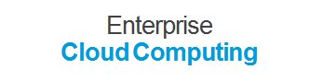
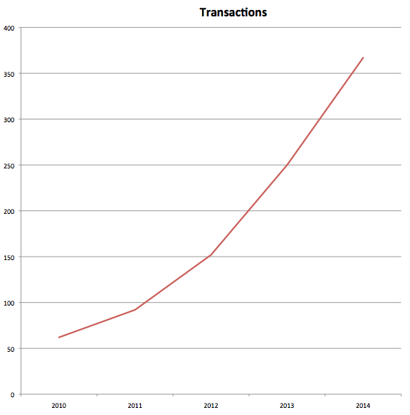

No Hardware/Software
Subscription Model
Automatic Upgrades
Constant Innovation
Billions
Notes:
more than 15K employees, graph (by FY) doesn’t even show it but already 2+ bb/day, yikes!

Slide 4
Notes:
From the folks in engineering, to the people in design, from the factory to the showroom, to the people on the line!

Slide 5

Notes:
From the folks in engineering, to the people in design, from the factory to the showroom, to the people on the line!

Slide 6

We Want a DevOps Transformation!
Source: ”Pink Blurry Unicorn under a Rainbow" by Zakeena - Own work.
Notes:
lower MTTR! shorter lead time! easier deployments! been a DevOps ambassador

Slide 7
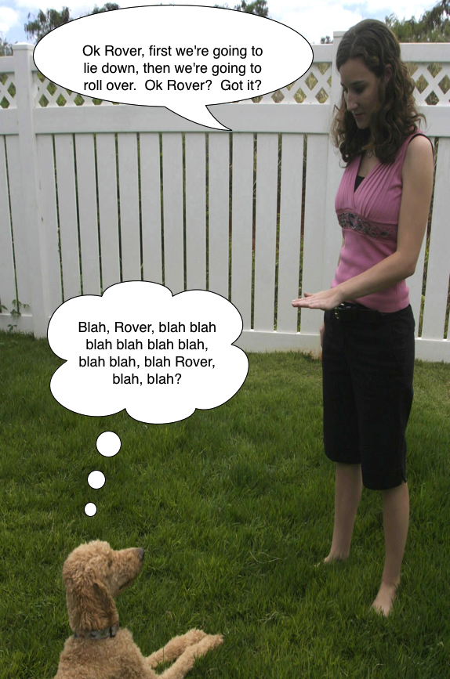
Hard to get the message to everyone
Source: http://www.flickr.com/photos/soldiersmediacenter/2657770369/ - Modified by dmangot
Notes:
Gary Larsen Far Side

Slide 8

Notes:
What QE hears, talk about ISD and Conor/Alan, customer focused quality mindset

Slide 9

Build Quality In
“Cease dependence on inspection to achieve quality. Eliminate the need for inspection on a mass basis by building quality into the product in the first place.”
W. Edwards Deming’s 14 Points

Slide 10
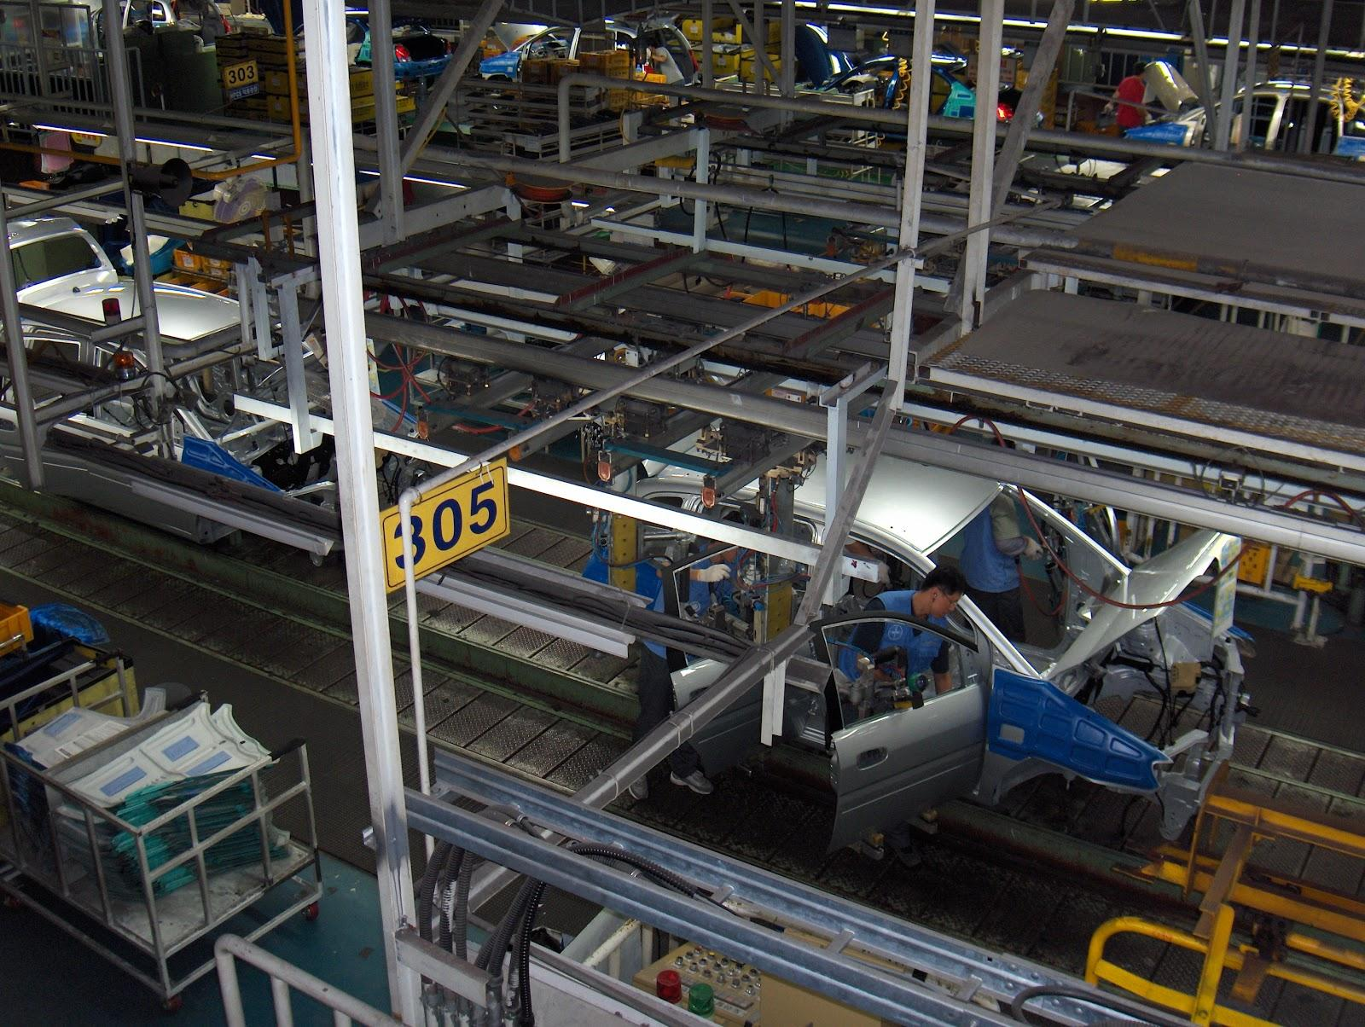
Quality Engineering: Definition
Discipline that deals with the analysis of a manufacturing system at all stages, to improve the quality of the production process and of its output.
http://www.businessdictionary.com/definition/quality-engineering.html
Source: "Hyundai car assembly line" by Taneli Rajala - Own work.
Notes:
Quality Engineering is about improving the output as well as the processes that generate the output.
Output can be Code, H/W, Design, etc.
Gene Kim’s 1st way

Slide 11

QE at Salesforce
Network of Guardian Angels
100% dedicated team resource
Skillset - Technology + Research
Collaboration - Across Borders
Source: "Angel 11" by Piotr Frydecki - Own work.
Notes:
Network of Guardian Angels keeping a watch of all aspects
Technology : Software, Infrastructure
Research: Ask questions to get more information to ask more questions; Proving and disproving theories

Slide 12

Testing isn’t the only way to guarantee Quality
QE Involved in all Stages
Risk Analysis & Mitigation
Testing/Validation Strategy
Tools Strategy
Production Validation Strategy
Source: http://www.npr.org/blogs/thesalt/2012/08/06/158201090/three-ways-lucille-ball-ruled-when-she-played-with-food
Notes:
Fits in with CAMS model
Risk Analysis - Planning, Reviews
Validation - Exploratory Testing, Blitz, Pairs Testing, Test Automation, Test Envs
Tools Strategy - CI, Test Frameworks
Production Validation Strategy - Post Release Monitoring, Canary Release, Staggered Releases, Destructive Testing

Slide 13

Latest Journey: DevOps and QE
Expanding QE to Infrastructure & Ops Teams as part of DevOps Transformation
Service
Software
Hardware
Process
Tools
Source: "Group people icon" by Sara 506 - Own work.
Notes:
Everyone wants “customers” delighted with all aspects of the services
Customers don’t care whether it is a Software or Infrastructure issue as long as the service is up.
How can QE partner with everyone to make this possible? Here are a few examples…..

Slide 14
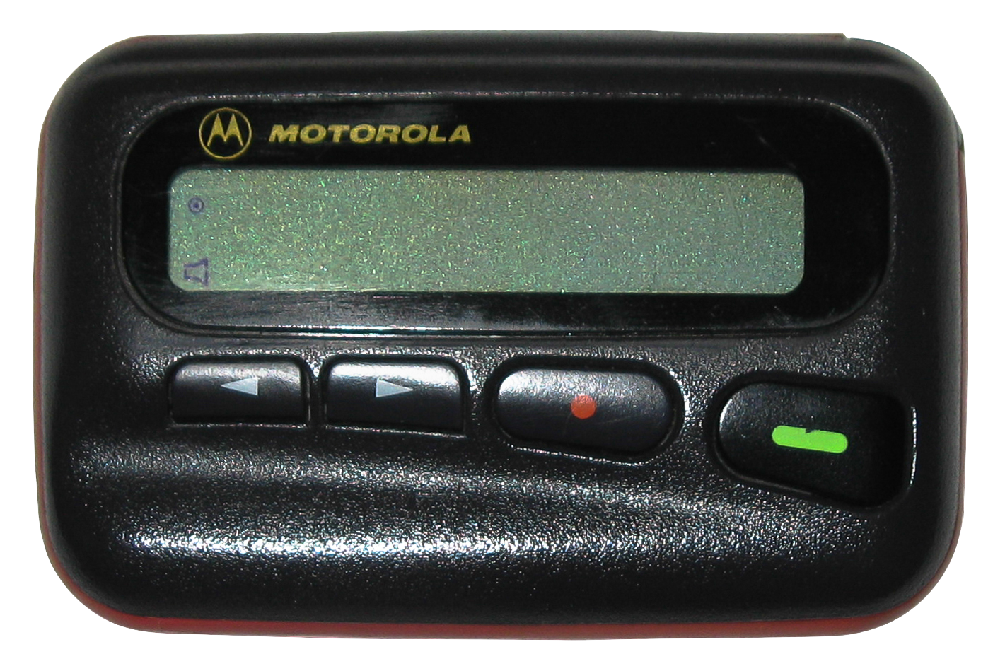
What Developers Hear
By Dme motorola.jpg: Starwhooper derivative work: VT98Fan (This file was derived from: Dme motorola.jpg) [CC-BY-SA-3.0 (http://creativecommons.org/licenses/by-sa/3.0)], via Wikimedia Commons
Notes:
Dave:

Slide 15
How to Bring Developers In
Empathy
Lots of carrot - pride in service
No more flying blind
Find their pain and fix it – other tools

Slide 16
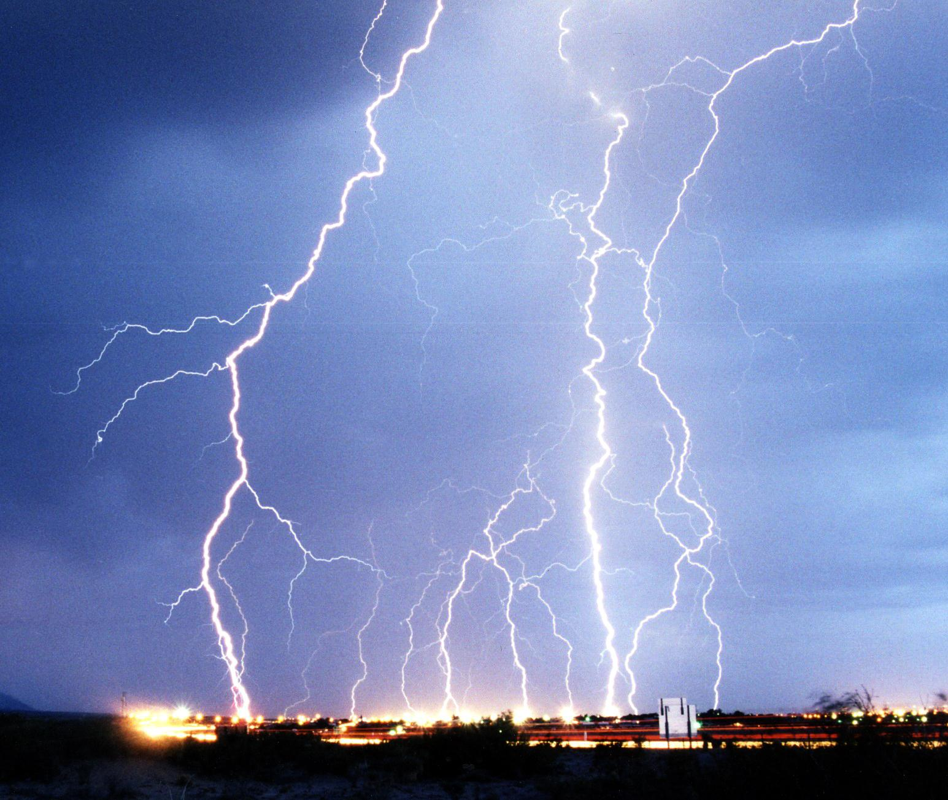
QE Collaboration with Dev
Design a system that assumes failure
Test the Design
Continuous Integration
Source: "Lightning3" by U.S. Air Force photo by Edward Aspera Jr. - United States Air Force, VIRIN 040304-F-0000S-002 (and VIRIN 060822-F-1111A-001).
Notes:
Test the Design
Find bugs even before code is written, dependencies, impact
Continuous Integration

Slide 17
Infrastructure Test Automation
Infrastructure Testing Tools are not in abundance
Salesforce QE Developed: Rouster
https://github.com/chorankates/rouster
Helps with Puppet Functional Tests
Notes:
Help with Functional Testing

Slide 18
Infrastructure Test Environments
 | Physical | Puppet in a Box (PIAB)
Cost | Up to millions | Free
Lead Time | Up to weeks or months | Minutes
Management | Functional roles | Yourself!
Notes:
PIAB: Development Environment for Puppet Code
Built on top of Vagrant to create Virtual Envs
Simulates Production in a local environment
Dave: This has been extended into ftests on Jenkins, acl testing, hbase, etc.

Slide 19
What Ops Hears
Notes:
Someone else is going to have to carry a pager too!
(sign me up for this one)

Slide 20
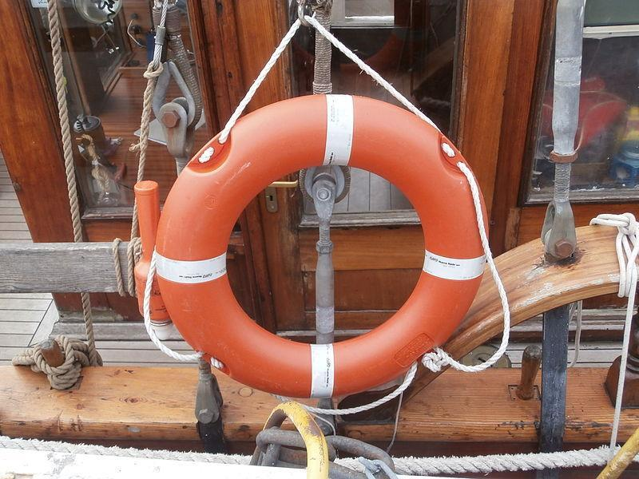
How to Bring Ops In
Notes:
Ha ha - talk about 1st DevOps internal mini-conf

Slide 21
QE Collaboration with Ops
Table Top Exercises
Game Days
“QE tries to break the system”
Notes:
Reena: Plans: Validation, Implementation, Rollback or Roll Forward
QE knows how to break the system
Ops knows how system will fail
Embrace Failure; Build Resiliency into the system

Slide 22
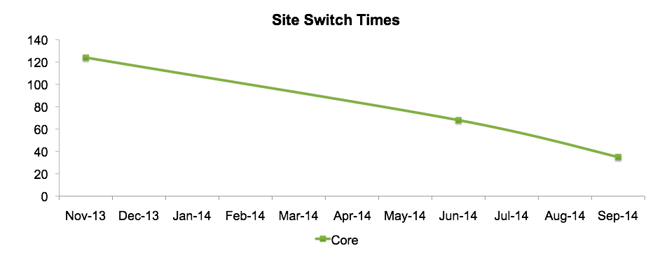
Destructive Testing Metrics
Destructive testing is a normal part of service deployment
Notes:
Dave: Just talk about as a generic service, nothing specific
Unknown what it was before testing, only estimates
Gene Kim’s 3rd way
also seeing more “days of green”, more signal/less noise

Slide 23
What Security Hears
Notes:
We’re going to need to give all the Devs access to Production!

Slide 24
How to Bring Security In
Offer them a spot early in the process
Collaborate throughout
Notes:
virtual appliances, what did security do with this?
Taher quote

Slide 25
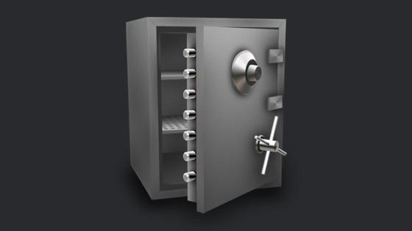
QE Collaboration with Security
Security Experts involved in design
Security Testing Experts
Security Tools
Source: http://commons.wikimedia.org/wiki/File:Safe_icon.jpg#mediaviewer/File:Safe_icon.jpg
Notes:
Build Security In just like Build Quality In
Build a group of QE Security Experts
Incorporate Security Testing tools into CI
Need to have a hacker mentality compared to being a customer advocate

Slide 26
Issue Remediation
Fix deployed in just hours
Change management considers Puppet changes “standard”
Non-puppet managed hosts still go through traditional change management
Notes:
Dave: “I for one welcome our new robot overlords”

Slide 27
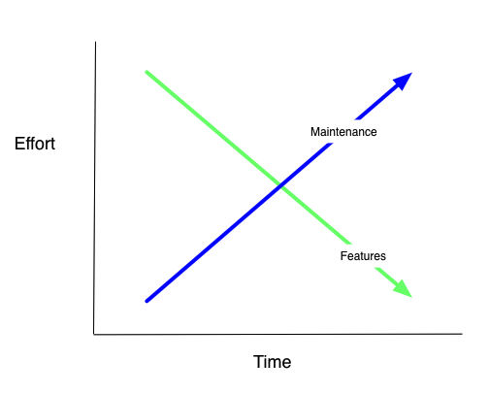
Future: DevOps and Quality
Service Ownership
Teams enabled to own all aspects of the service
Include more groups
Product
Sales
Compliance
Marketing
Notes:
less time on features, more time on fixing bugs
Service Ownership - Service Delivery Playbook

Slide 28
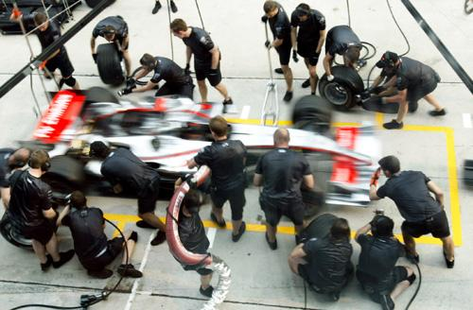
Quality is Everyone’s Responsibility
“It is a mistake to assume that if everybody does his job, it will be all right. The whole system may be in trouble” - W. Edwards Deming
Source: "McLaren pit work 2006 Malaysia" by Kamalsell - Flickr.
Notes:
Dave then Reena: Quality isn’t just QE’s responsibility. Service Ownership.

Slide 29
Quality in a DevOps Transformation
Bring everyone together to deliver enterprise quality service to the customer
Focus on preventing bugs with faster feedback loops
Incremental Improvements to process and tools
If you are building a culture of quality, then you are adopting DevOps principles
Notes:
They don’t care whether it is a Software or Infrastructure issue as long as the service is up.
Achieves goal of QE to represent the customer
Rapid delivery of high quality software is a goal shared with DevOps
DevOps 3 Ways: System, Feedback Loops, Iterations

Slide 30
Takeaways
Quality is everyone’s responsibility
Continuous quality mindset
Leverage your Quality Engineers for your DevOps transformation
Notes:
need Culture (quality mindset) more than tools

Slide 31
Your Experience
How to find Infrastructure QEs?
Who are the champions of quality at your companies?
Product sees DevOps as more tech debt and less features, how do we bring them along?
Notes:
need Culture (quality mindset) more than tools

